Slide 1
Disease prediction
Harnessing Data for Proactive Healthcare Management
Final Project: Group 4- Robyn Leslie, Jennifer Hooker, Traci Ellis, Brittany Butchkoski

Slide 2
Disease Prediction Introduction
Disease prediction plays a crucial role in healthcare by leveraging advancements in technology and data analytics to anticipate and manage health risks proactively. It allows for
Early Detection: Identify health risks before they escalate.
Preventive Healthcare: Implement measures to mitigate risk factors.
Personalized Medicine: Tailor interventions based on individual characteristics.
Resource Optimization: Allocate resources efficiently for high-risk patients.
Population Health Management: Inform policies and interventions for better public health outcomes.
Overall, disease prediction represents a paradigm shift in healthcare, moving towards a proactive and personalized approach that emphasizes prevention, early detection, and targeted interventions. By harnessing the power of data and technology, disease prediction has the potential to revolutionize healthcare delivery, improve patient outcomes, and enhance the overall quality of care.
Notes:
Early Detection- early detection enables timely intervention, which can significantly improve patient outcomes and reduce the severity of illnesses.
Preventative Healthcare - By predicting the likelihood of certain diseases or conditions, healthcare providers can implement preventive measures to mitigate risk factors and promote healthier lifestyles.
Personalized Healthcare - Disease prediction models can be tailored to individual patients based on their unique medical history, genetic makeup, lifestyle factors, and environmental influences.
Resource Allocation - Healthcare resources, including medical staff, facilities, and funding, are finite. Disease prediction helps optimize resource allocation by prioritizing high-risk patients for screening, monitoring, and intervention. This ensures that resources are allocated efficiently, maximizing their impact on patient health outcomes.
Population Health Management- Disease prediction at a population level provides valuable insights into disease trends, risk factors, and prevalence rates. This information enables public health agencies and policymakers to develop targeted interventions, allocate resources effectively, and implement policies aimed at improving overall population health and reducing healthcare disparities.

Slide 3
Disease Prediction
OBJECTIVE "Develop an algorithm to proactively identify disease symptoms and predict patient risk, enabling early interventions and proactive healthcare management.”
SCOPE: Disease Focus, Data Sources, Machine Learning Techniques, Predictive Data, Limitations & Restraints.
Key Features: Data Prep, Coding, Confusion Matrix, Database Setup, Neural Networking, Metrics, and more.
Challenges, Considerations and Limitations of the data

Slide 4
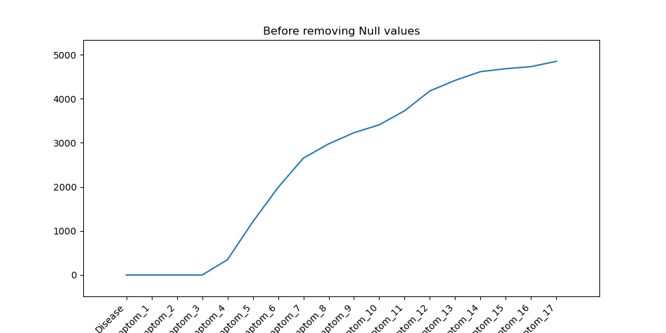
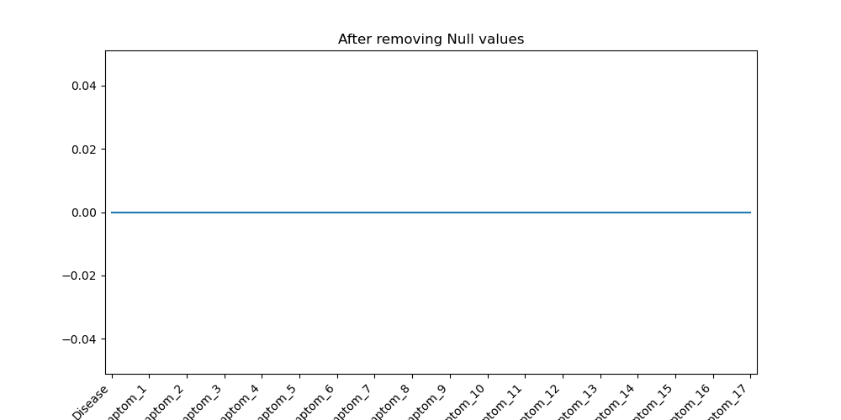
Disease Prediction: Data Collection & Processing
Data Sets used: Diseases with Symptoms & Diseases with Symptom Severity (data sets pulled from Kaggle)
The code provided is designed to train a neural network to predict whether a patient is at risk for a disease based on symptoms and their severity.
Data Clean Up: in training an algorithm it is important to remove Null values or replace with “0”. As some of the diseases represented in the datasets only shown a few symptoms whereas, others shown Null values.
Reasons why you replace the Null values: Numerical Computations; Visualization, Algorithm Behavior (for our purpose), Statistical Measures, etc.

Slide 5
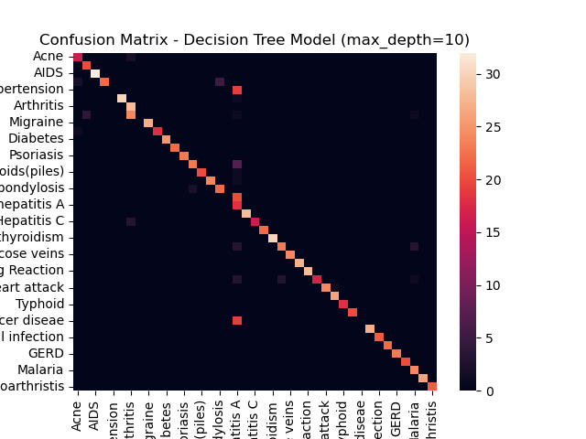


Disease Prediction Decision Tree
The F1-scores and accuracies improve as we moved from the initial model to the 3rd model, indicating that the models are becoming more effective in capturing patterns in the data.
The 3rd model has the highest F1-score and accuracy, suggesting that it performs the best among the three.
based on the provided metrics, the 3rd model with max_depth=20 and min_samples_split=5 seems to be the best-performing model among the three.
Confusion Matrix 1
Fi Score- 84.58 %
Accuracy- 87.09 %
Confusion Matrix 2
Fi Score- 98.01 %
Accuracy- 98.17 %
Confusion Matrix 3
Fi Score- 99.58 %
Accuracy- 99.59 %

Slide 6
Disease Prediction Limitations, Considerations, Constraints
Data Privacy and Security - Utilizing patient data for machine learning poses challenges related to privacy and security. Robust data protection measures and compliances with regulations such as HIPPA , are crucial to maintaining patient trust.
Algorithm transparency and explainability- Ensuring transparency and explainability of machine learning algorithms is essential, especially in the healthcare context where decisions impact patient well-being. Clinicians and patients should understand how predictions are made to build trust in the technology.
Ethical Considerations- ethical considerations such as potential bias in training data and model outputs must be carefully addressed. Machine Learning Models should be designed and validated to be fair and unbiased across diverse patient populations

Slide 7
Disease Prediction Conclusion
Machine Learning in disease risk prediction holds immense potential to revolutionize healthcare by:
Enabling early detection
Personalized intervention
Optimized resource utilization
While addressing challenges related to data privacy, algorithm transparency and ethical considerations, the benefits far outweigh the concerns.
Machine Learning driven risk prediction has the capacity to transform healthcare into a more proactive, patient-centered, and cost-effective system that will ultimately improve future health outcomes and quality of life.

